Slide 1
KIGALI IKINDEPENDENT UNIVERSITY
CSM107: Computer architecture and hardware maintenance
Lecturer : Kwizera Jean Pierre
Cell phone : 0785520535
E-mail : kwijpeter01@gmail.com

Slide 2
Chapter 2: COMPUTER ARCHITECTURE

Slide 3
Definitions
Computer
A computer is a general purpose device that can be programmed to carry out a finite set of arithmetic or logical operations.
Since a sequence of operations can be readily changed, the computer can solve more than one kind of problem.
Technically, a computer is a programmable machine.
This means it can execute a programmed list of instructions and respond to new instructions that it is given.

Slide 4
Definitions
Architecture
"Architecture" can mean:
Orderly arrangement of parts; structure.
Computer Science: The overall design or structure of a computer system, including the hardware and the software required to run it, especially the internal structure of the microprocessor.

Slide 5
Architecture
The term "architecture" has been adopted to describe the activity of designing any kind of system, and is commonly used in information technology.

Slide 6
Computer architecture vs. computer organization vs. Computer Design
Computer Organization is concerned with the way the hardware components operate and the way they are connected together to form the computer system.
Computer Design is concerned with the hardware design of the computer.
Once the computer specification are formulated, it is the job of the designer to develop hardware for the system.
Computer design is concerned with the determination of what hardware should be used and how the parts should be connected.
Computer Architecture is concerned with the structure and behavior of the computer as seen by the user.

Slide 7
Computer Generation
The first generation of computers refers to the early stages of computer development.
This generation is the beginning of computer technology that gained further progress to make computers more powerful and smaller.
The computer has evolved from a large-sized simple calculating machine to a smaller but much more powerful machine.

Slide 8
The evolution of computer to the current state is defined in terms of the generations of computer.
Each generation of computer is designed based on a new technological development, resulting in better, cheaper and smaller computers that are more powerful, faster and efficient than their predecessors.

Slide 9
5 GENERATIONS OF COMPUTERS:
Technology in each generation:
First Generation: Vacuum Tubes
Second Generation: Transistors
Third Generation: Integrated Circuits
Fourth Generation: Microprocessors
Fifth Generation: Artificial Intelligence

Slide 10
First Generation Computers (1940-1956)
• The first computers used vacuum tubes for circuitry and magnetic drums for memory.
• They were often enormous and taking up entire room.
• First generation computers relied on machine language.
• They were very expensive to operate and in addition to using a great deal of electricity, generated a lot of heat, which was often the cause of malfunctions.
• The UNIVAC and ENIAC computers are examples of first-generation computing devices.

Slide 11
The first general purposes programmable electronic computer was the Electronic Numerical Integrator And Computer (ENIAC), built by J. Presper Eckert and John V. Mauchly at the University of Pennsylvania.
Eckert and Mauchly later designed what was possibly the first commercially successful computer, the UNIVAC (Universal Automatic Computer); in 1952.
First-generation computers relied on machine language, the lowest-level programming language understood by computers, to perform operations, and they could only solve one problem at a time.

Slide 12
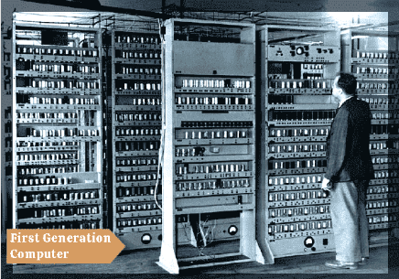
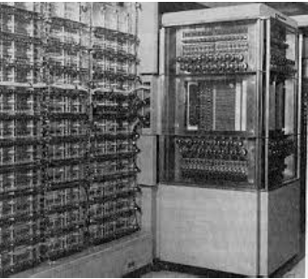

Slide 13
Characteristics of first generation computers:
Some essential characteristics or features of the first generation computers are as follows:
Use of vacuum tubes technology
Based on machine language only
Use of punch cards as an input device
Use of magnetic tapes as memory device
Use of paper tape as an output device

Slide 14
Advantages :
• It was only electronic device
• First device to hold memory
Disadvantages :
• Too bulky i.e large in size
• Vacuum tubes burn frequently
• They were producing heat
• Maintenance problems

Slide 15
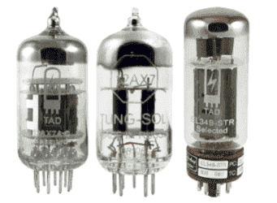
During this period, computers were developed using Vacuum tubes as the main component.
A vacuum tube is a device that helps amplify signals by controlling the motion of electrons in an evacuated space.
The following image shows the structural view of vacuum tubes:

Slide 16
Second Generation Computers (1956-1963)
Transistors replaced vacuum tubes in the second generation of computers.
Second-generation computers moved from cryptic binary machine language to symbolic.
High-level programming languages were also being developed at this time, such as early versions of COBOL and FORTRAN.
This generation of computers also included hardware advances like magnetic core memory, magnetic tape, and the magnetic disk.
These were also the first computers that stored their instructions in their memory.

Slide 17
A number of high level programming languages were introduced and these include FORTRAN (1956), ALGOL (1958), and COBOL (1959).
Advantages :
Size reduced considerably
The very fast
Very much reliable
Disadvantages :
They over heated quickly
Maintenance problems

Slide 18
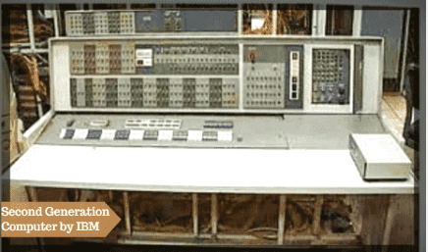

Slide 19
Third Generation Computers (1964-1971)
The development of the integrated circuit was introduced the third generation of computers. Another name for a chip, an integrated circuit (IC) is a small electronic device made out of a semiconductor material.
Transistors were miniaturized and placed on silicon chips, called semiconductors. Computer chips, both for CPU and memory, are composed of semiconductor materials.
A semiconductor is a substance that has specific electrical properties that enable it to serve as a foundation for computers and other electronic devices.

Slide 20
Instead of punched cards and printouts, users interacted with third generation computers through keyboards and monitors and interfaced with an operating system.
Allowed the device to run many different applications at one time.
Advantages :
ICs are very small in size
Improved performance
Production cost cheap
Disadvantages :
Air conditioning was required.
ICs are sophisticated

Slide 21
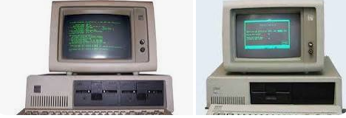

Slide 22
The features of computers belonging to this generation
Used ICs
Relatively very small in size
Made use of operating system
High processing speed
More reliable
Power efficient
Use of high level languages (C++, Java)
Large memory
Low cost

Slide 23
Fourth Generation Computers (1971-present)
The microprocessor brought the fourth generation of computers, as thousands of integrated circuits were built onto a single silicon chip.
The Intel 4004 chip, developed in 1971, located all the components of the computer.
From the central processing unit and memory to input/output controls—on a single chip.
Fourth generation computers also saw the development of GUIs, the mouse and handheld devices.

Slide 24
Fourth generation computers became more powerful, compact, reliable, and affordable.
As a result, it gave rise to Personal Computer (PC) revolution.
In this generation, time sharing, real time networks, distributed operating system were used.

Slide 25
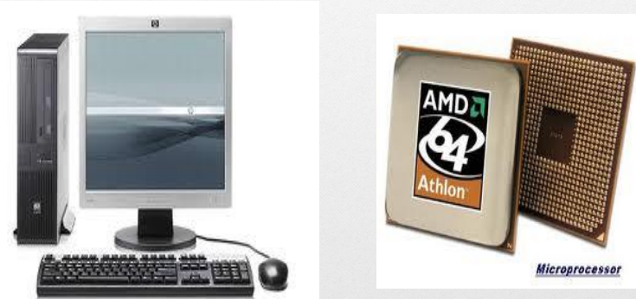

Slide 26
Advantages of Fourth Generation of Computer
They were developed for totally general purpose use (general-purpose computers).
Smaller in size and much more reliable than other generations of computers.
The heat generation was negligible.
Portable and cheaper than the older versions.
Fourth-generation computers were much faster than the older generations.
Graphics User Interface (GUI) technology was exploited to offer more comfort to users. PCs became more affordable and widespread during this period.
Less repair time and maintenance cost.
They were developed for commercial production as well.
All types of High-level languages can be used in this type of computers

Slide 27
Disadvantages of the Fourth Generation of Computer
Very advanced technology was required to fabricate the ICs (Integrated Circuits).
A high-quality and reliable system or technology can only make the ICs.
Cooler is required (Fan)
The latest technology is required for the manufacturing of Microprocessors.

Slide 28
Fifth Generation Computers (present and beyond)
Fifth generation computing devices, based on artificial intelligence.
Are still in development, though there are some applications, such as voice recognition.
The use of parallel processing and superconductors is helping to make artificial intelligence a reality.
The goal of fifth-generation computing is to develop devices that respond to natural language input and are capable of learning and self-organization.

Slide 29
Artificial intelligence (AI) is a wide-ranging branch of computer science in which smart machines are built to perform tasks that typically require human intelligence.
In simpler terms, it is making computers think like humans.

Slide 30
The main features of the fifth generation computer are,
Development of true artificial intelligence
Development of Natural language processing
Advancement in Parallel Processing
Advancement in Superconductor technology
More user-friendly interfaces with multimedia features
Availability of very powerful and compact computers at cheaper rates.
The fifth-generation computers will use super large-scale integrated chips.
They will have artificial intelligence.

Slide 31
They will be able to recognize images and graphs.
Fifth-generation computer aims to be able to solve highly complex problem including decision making, logical reasoning.
They will be able to use more than one CPU for faster processing speed.
Fifth-generation computers are intended to work with natural language.
These computers are much faster than other generation computers.
It is easier to repair these computers.
These computers are much smaller in size than other generation computers
They are portable and easy to handle.
Development of true artificial intelligence.

Slide 32

Classification of computers:

Slide 33
CLASSIFICATION OF COMPUTERS
Computers can be classified according to
Size and power
Function
Technology
Purpose

Slide 34
Classification of computers according to the size and power
Based on physical size computers can be classified into four main groups
Super computers
Mainframe computers
Minicomputers
Microcomputers

Slide 35
a) Supercomputers
Supercomputers are the fastest, largest, most expensive & also the most powerful computers available.
Characteristics
Fastest computers
Largest in size
Most expensive
Huge processing power
Very heavy
Generate a lot of heat
Use multiple processors
They are operated by computer specialists. A Supercomputer can be operated by over 500 users at the same time

Slide 36
Applications
Scientific research
Defense and weapon analysis
Nuclear energy research
Weather forecasting
Petroleum research.
Note. These tasks use large amounts of data, which need to be manipulated within a very short time.
Examples of Supercomputers:
CRAY T3D
NEC-500.
CDC 6600
ABC (Atanasoff-Berry Computer)
ENIAC

Slide 37
2) Mainframe computers
Mainframes are less powerful & less expensive than supercomputers. Mainframe executes many programs concurrently and supports many simultaneous execution of programs.
They are mostly found in government and big organizations such as banks, hospitals, airports etc.
Characteristics
Have a large storage capacity
Large in size
Multi-user
Multi-processing, Supports a variety of peripherals

Slide 38
Areas where mainframe computers are used:
Mainframe computers are mostly found in government departments, big organizations and companies which have large information processing needs, e.g., they are used;
In Banks & Hospitals for preparing bills, Payrolls, etc.
In communication networks such as the Internet where they act as Servers.
By Airline reservation systems where information of all the flights is stored.
Examples of Mainframes:
IBM 360,4381.
ICL 39 Series.
CDC Cyber series.
UNIVAC

Slide 39
c) Minicomputers
A Minicomputer is physically smaller than a mainframe. However, it can support the same peripheral devices supported by a mainframe.
Characteristics
Multi-user, e.g., can be operated by 6 users at a time.
Easier to maintain compared to mainframes.
Cheaper than the mainframes
They handle small amounts of data, are less powerful, & have less memory than the mainframes.
Minicomputers are slow compared to mainframe computers.

Slide 40
Applications
Used in scientific laboratories
Used in research institutions
Engineering plants
Automatic processing
Also they are well adapted for functions such as
Accounting
Word processing
Database administration

Slide 41
d) Microcomputers
Microcomputers are the PCs mostly found today in homes, schools & many small offices. They are called Personal Computers (PCs) because they are designed to be used by one person at a time.
Characteristics
Are cheaper than both mini & mainframe computers.
Are very fast (i.e. have high processing speeds).
Small in size, hence they occupy less space in an office.
Are more energy efficient (i.e., consume less power).
Are more reliable than the early Mainframe computers.

Slide 42
Areas where microcomputers are used:
Microcomputers are commonly used in:
Training and learning institutions such as schools.
Small business enterprises, and
Communication centers as terminals.
The following are the various types of microcomputers in operation today arranged in descending order according to size.
Desktop computer; is designed to be placed on top of an office desk
Notebook or laptop; portable convenient for mobile users.
Personal Digital Assistant(PDA); Is small enough to fit in the pocket

Slide 43
Types of computers according to functions
Regardless of the size and processing power, a computer can be classified according to functions they perform.
In this case, we have servers, workstations and embedded computers.
Servers and workstations are general purpose computers used to provide access to resources on a network while special purpose computers are dedicated to a single task.

Slide 44
a) Servers
A server is a dedicated computer that provides hardware or software resources to other computers on a local area network (LAN) or a over the Internet.
Unlike desktop computers that have standard input and output devices attached. do not require such peripheral devices because they are accessed remotely using remote access software.
Because servers are expensive, a powerful desktop computer may be converted into a server by adding the appropriate hardware and software resources.

Slide 45
Generally, servers may be classified according to the task they perform.
For example, a file server provides massive storage devices dedicated to storing files while a print server is used to access to more printers, and a network server is a computer that manages network traffic.

Slide 46
b) Workstation
A workstation is a name given to a computer connected to a server or network intended to be used by one person at a time, it is commonly connected to a server.
This means that all users who utilize a computer at their job or school are using a workstation.
Commercially, workstations are used for business or professional use such as graphics design, desktop publishing and software development.

Slide 47
Are powerful, single-user computers.
They have the capacity to store and process large quantities of data, but they are only used by one person at a time.
However, workstations are typically linked together to form a computer network called a local area network, which means that several people, such as staff in an office, can communicate with each other and share electronic files and data.

Slide 48
c) Embedded computers
Embedded computers are computing devices designed for a specific purpose.
An embedded system is a combination of computer hardware and software designed for a specific function.
Generally, an embedded computer has an operating system that only runs a single application.
Examples of embedded computing devices include ATM(Automated Teller Machine) machines, MP3 players, routers, GPS(Global Positioning System) systems…..

Slide 49
Other computer’s :
Personal computers (PCs)
Also called microcomputers, are the most popular type of computer in use today.
The PC is a small-sized, relatively inexpensive computer designed for an individual user.
Today, the world of PCs is basically divided between IBM-compatible and Macintosh-compatible machines, named after the two computer manufacturers.

Slide 50
Computers may be called ‘desktop’ computers, which stay on the desk, or ‘laptop’ computers, which are lightweight and portable.
Organizations and individuals use PCs for a wide range of tasks, including word processing, accounting, desktop publishing, preparation and delivery of presentations, organization of spreadsheets and database management.
Entry-level PCs are much more powerful than a few years ago, and today there is little distinction between PCs and workstations.

Slide 51
Laptops
Are also called notebook computers.
These are the portable computers.
Because laptops are meant to be used on the go, they have a battery which allows them to operate without being plugged into a power outlet.
Laptops also include a power adapter that allows them to use power from an outlet and recharges the battery.

Slide 52
Palmtops
Palmtops are also called” handheld” computers.
Palmtop a type of computer that is small enough to hold with one hand
These are computing devices, which are small enough to fit into your palm.
The palmtops are generally kept for personal use such as taking notes, developing a list of friends, keeping track of dates, agendas etc.
The Palmtop can also be connected to a PC for downloading data.
It also provides value-added features such as voice input, Internet, cell phone, camera, movie player and GPS.
PDAs are also known as pocket computers or palmtop computers.

Slide 53
Classification according to the technology / data to be processed
Usually, there are two forms of data; Digital data, and Analogue data. Computers can be classified according to the type of data they can process as either.
Digital computers.
Analogue computers
Hybrid computers.

Slide 54
a. Digital Computers
This is the most commonly used type of computers.
Digital computers process data that is discrete in nature. Discrete data also known as digital data is usually represented using a two-state. .
It can process both numeric & alphabetic data within the computer, e.g., 0, 1, 2, 3…, A,B,C….
Their operation is based on 2 states, “ON” & “OFF” or on digits “1” & “0”. Therefore, any data to be manipulated by a digital computer must first be converted to digital form.
Most of the devices found at homes today are digital in nature.
Examples:
¨A Television with a button which is pressed to increase or decrease the volume.
¨Digital watches.
¨Calculators.

Slide 55
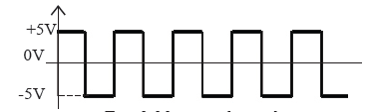
Digital computers perform calculations and logical comparisons by representing data and instructions as binary digits.
This means that digital computers must convert data such as text, numbers, images, video and sound into a series of zeros and ones

Slide 56
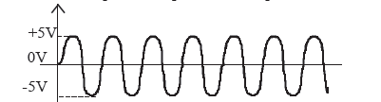
b) Analogue computers.
An Analogue computer is a computer that operates on continuous data.
They carry out their data processing by measuring the amount of change that occurs in physical attributes/quantities, such as changes in electrical voltage, speed, currents, pressure, length, temperature, humidity, etc.

Slide 57
c) Hybrid Computers
A computer that processes both analog and digital data.
A hybrid computer is a type of computer that offers the functionalities of both a digital and an analog computer.
For example, in hospital’s , analog devices might measure the patients temperature, blood pressure and other vital signs.
These components are used to monitor the patient’s vital sign and send signals if any abnormal readings are detected.
These measurements which are in analog might then be converted into numbers and supplied to digital components in the system.
Hybrid computers are mainly used for specialized tasks.

Slide 58
CLASSIFICATION ACCORDING TO PURPOSE.
Computers can be classified according to the tasks they perform as general or special purpose computers.
a) General purpose computers
They are the most common types of computers in use today. Their flexibility enables them to be applied in a wide range of applications like;
Document processing
Performing calculations,
Accounting,
Data and information management
Examples of general-purpose computers: Mainframes, Minicomputers, Microcomputers & Laptops used in most offices & schools.

Slide 59
b) Special-purpose computer.
A special-purpose computer is designed to handle/accomplish a particular specific task only.
Special-purpose computers are designed for one specific task or class of tasks and wouldn't be able to perform general computing tasks.
Such computers cannot perform any other task except the one they were meant to do.
A Special-purpose computer is dedicated to a single task; hence it can perform it quickly & very efficiently.
Examples of special-purpose computers:
Robots used in a manufacturing industry for production only.
Mobile phones used for communication only.
Calculators that carry out calculations only.
Computers used in Digital watches.
For example, a router is a special-purpose computer designed to move data around a network., Computer used in robots and Cash machines

Slide 60
Thank you for your kind attention!
END OF CHAPTER TWO !!!

